Slide 1
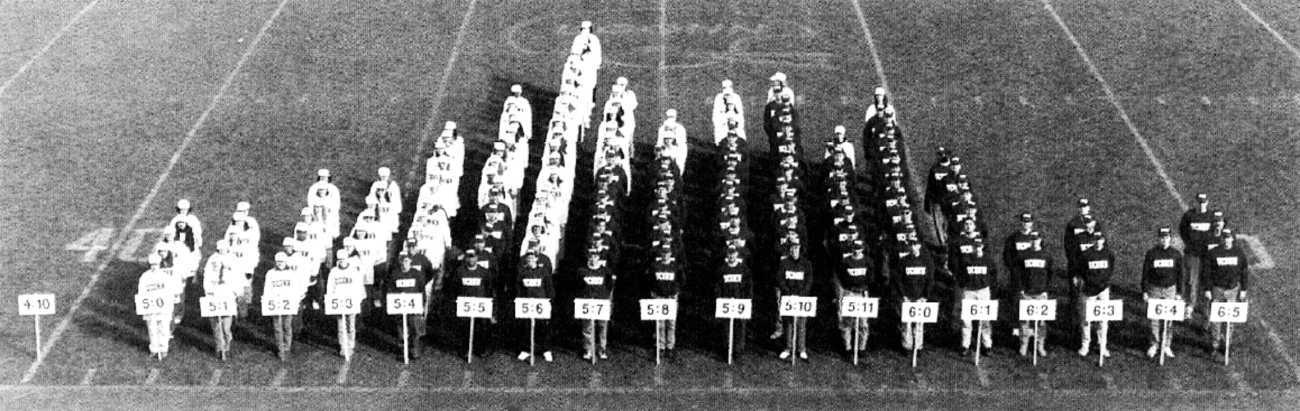
Descriptive Statistics

Slide 2

Statistics
A set of mathematical procedures for organizing, summarizing, and interpreting information
“To function efficiently in today’s world, you need math. The world is so technical, if you plan to work in it, a math background will let you go farther and faster.”

Slide 3
Two Types of Statistics
Descriptive statistics:
Organize, summarize, and communicate a group of numerical observations
Inferential statistics:
Use sample data to make inferences about the properties of the larger population or draw principled conclusions about the differences observed in descriptive data

Slide 4
Frequencies
Step 1

Slide 5
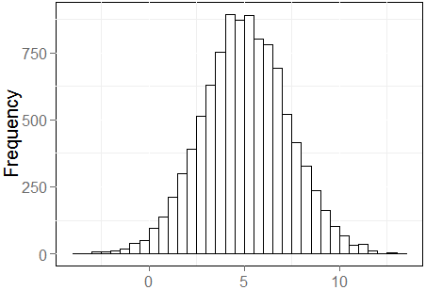
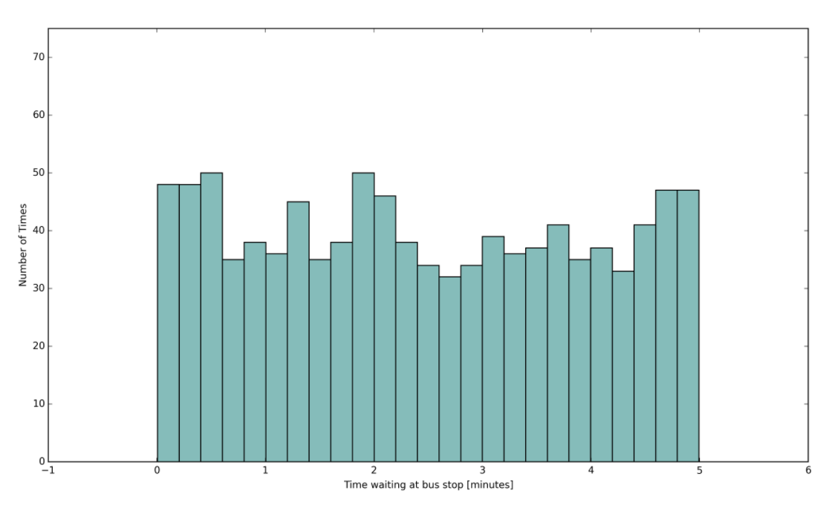
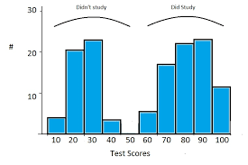
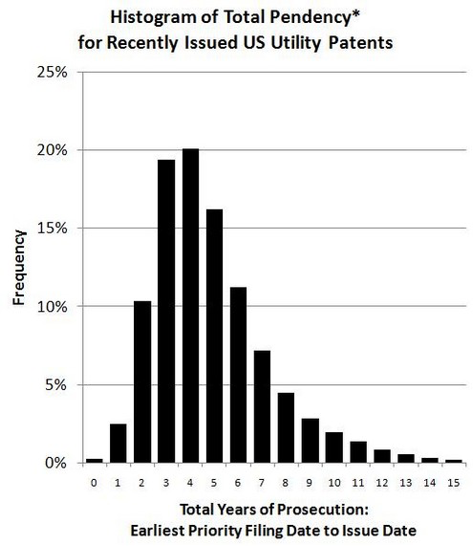
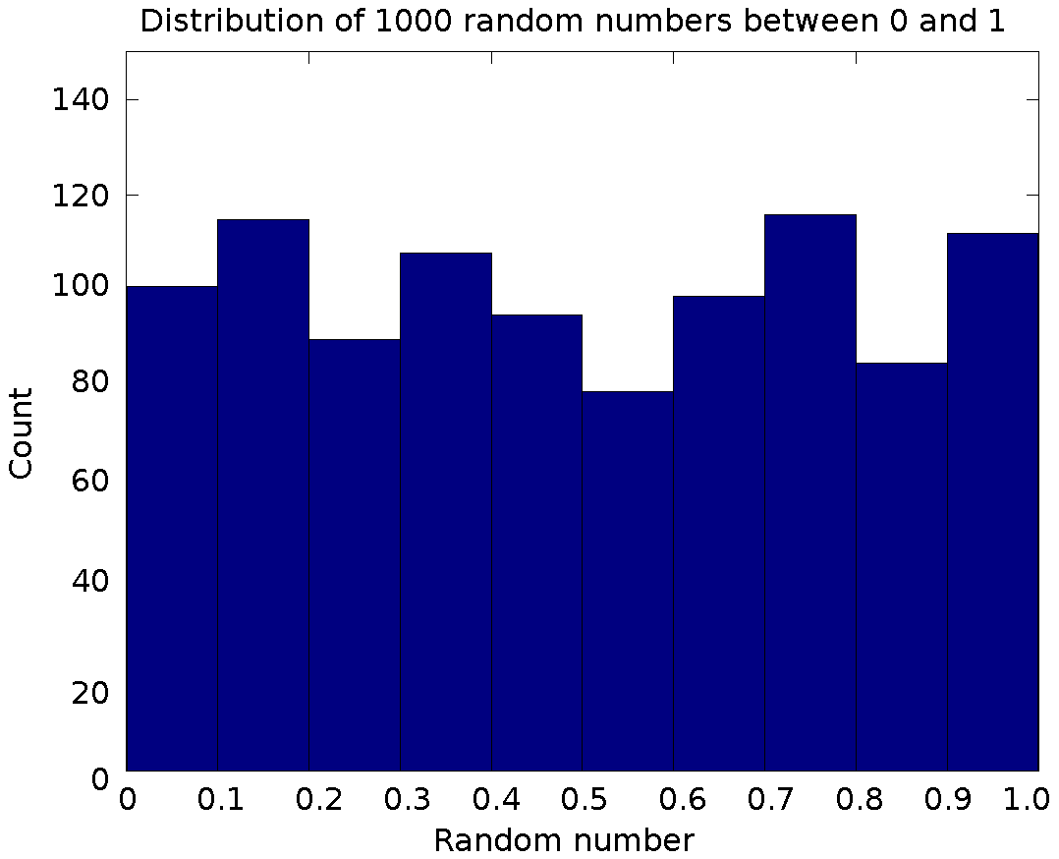
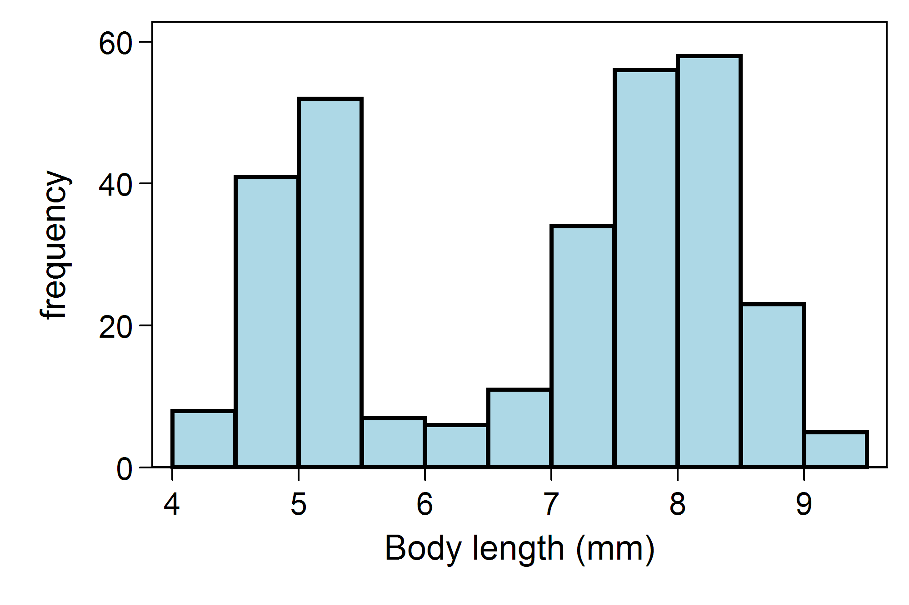
Types of Distributions by Mode
Unimodal
Bimodal
Uniform

Slide 6
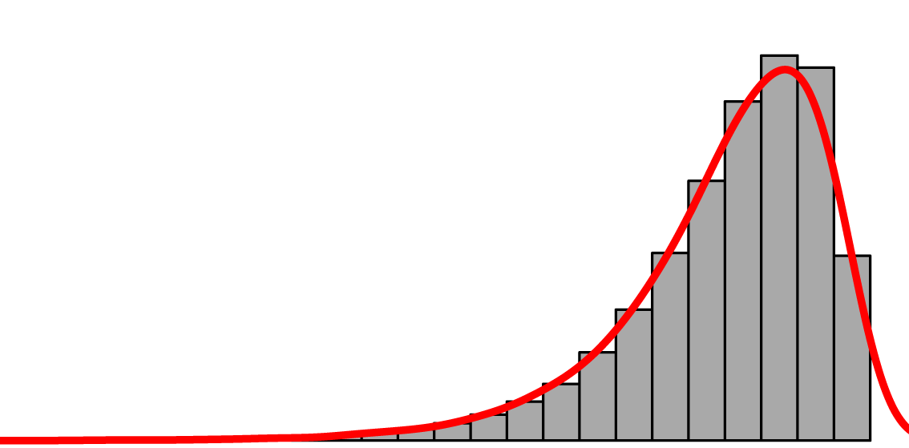
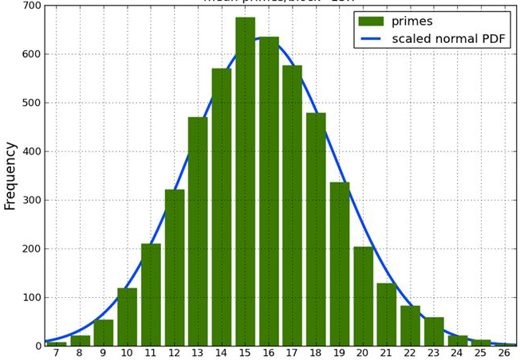
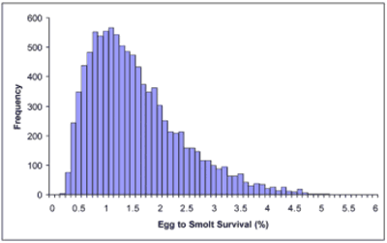
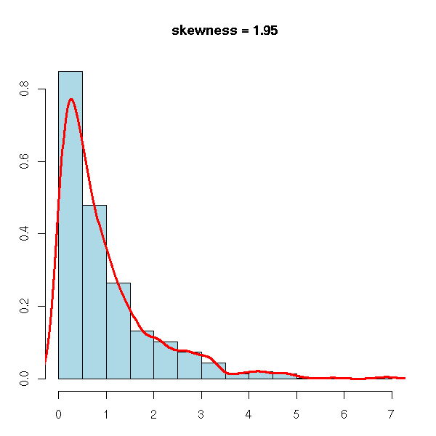
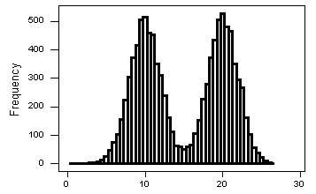
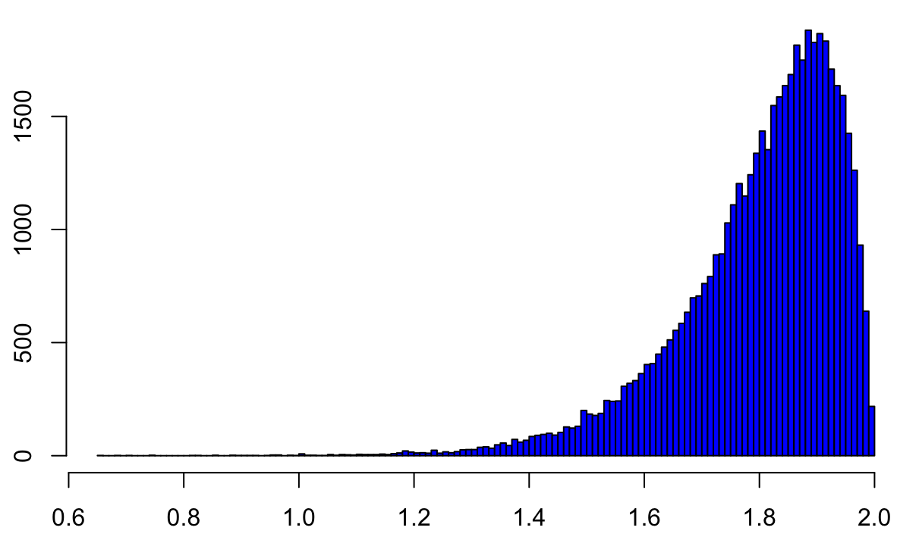
Types of Distributions by Skew
Symmetric
(no skew)
Positive (right) skewed
Negative (left) skewed

Slide 7
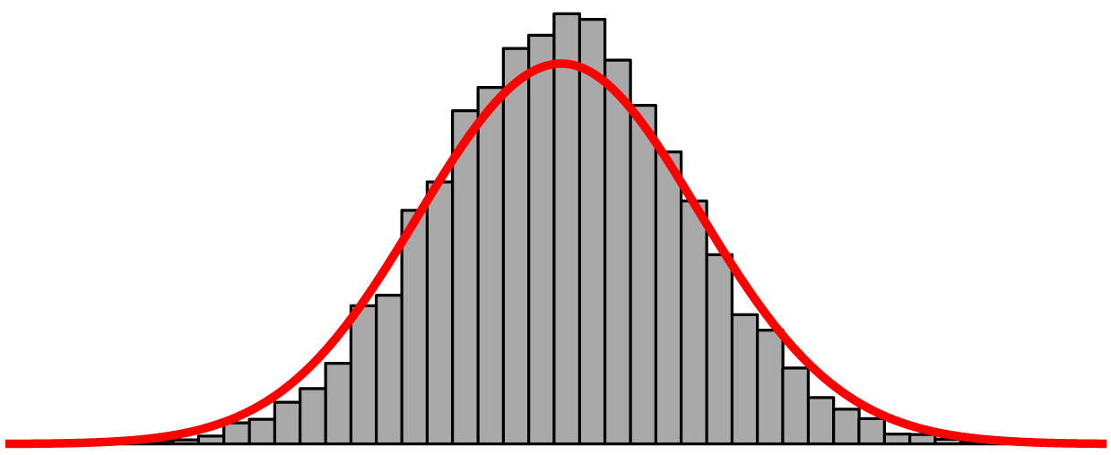
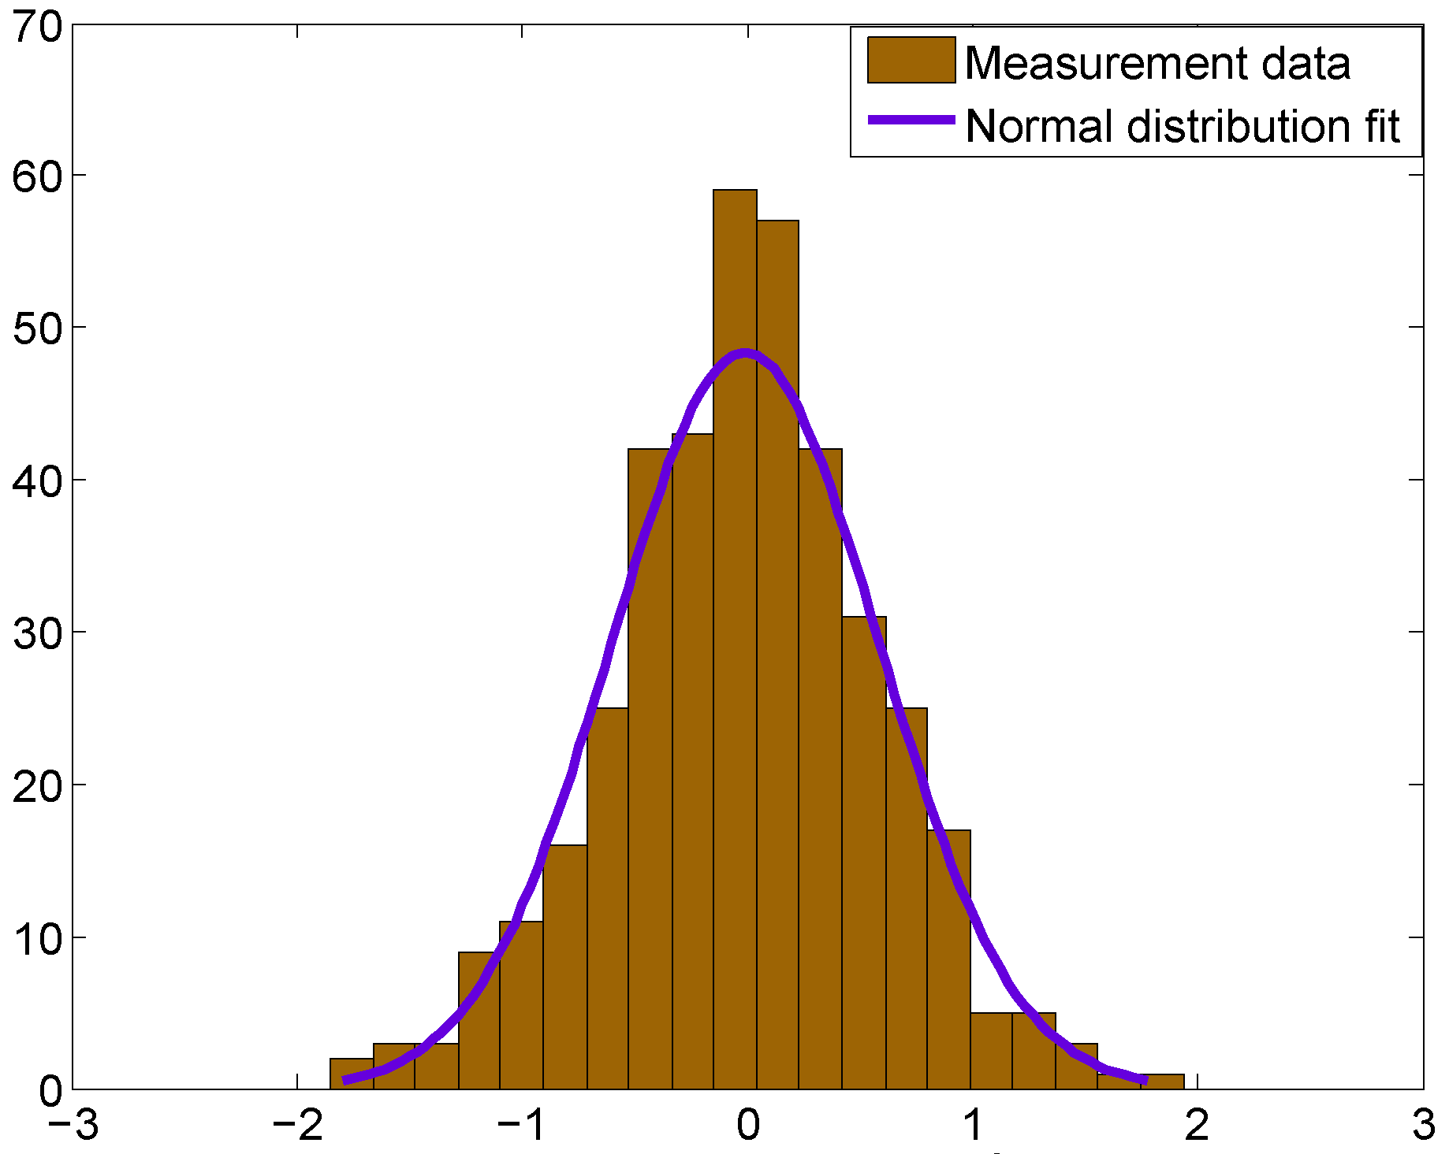
“Normal” Distributions

Slide 8
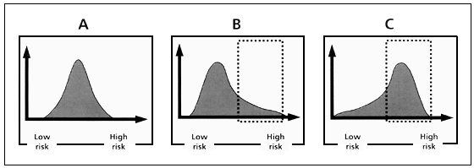
Name that distribution!
Unimodal, Symmetric (no skew)
Unimodal, Positive Skew
Unimodal,
Negative Skew

Slide 9
MEASURES OF CENTRAL TENDENCY
Step 2 in looking at and describing results

Slide 10
What is a central tendency?
A statistical measure (descriptive stat) that represents the central or typical value of a distribution of data with a single number
 | Average Temperature | Average Precipitation
New York City | 55° | 42”
Austin | 69° | 29”
San Francisco | 57° | 22”
Seattle | 53° | 34”

Slide 11
Imagine you knew the following
Class A grades:
Class B grades:
 | Grade
Student 1 | 100
Student 2 | 90
Student 3 | 85
Student 4 | 75
Student 5 | 75
Student 6 | 75
Student 7 | 99
Student 8 | 98
Student 9 | 97
 | Grade
Student 1 | 90
Student 2 | 90
Student 3 | 91
Student 4 | 75
Student 5 | 90
Student 6 | 75
Student 7 | 82
Student 8 | 98
Student 9 | 67

Slide 12
Measures of central tendency
Mean: Average of all scores
Median: Middle value in a distribution
Mode: Most common response value

Slide 13
Mode
Median
Frequency
Mean
40 50 60 70 80 90 100
Performance on test

Slide 14
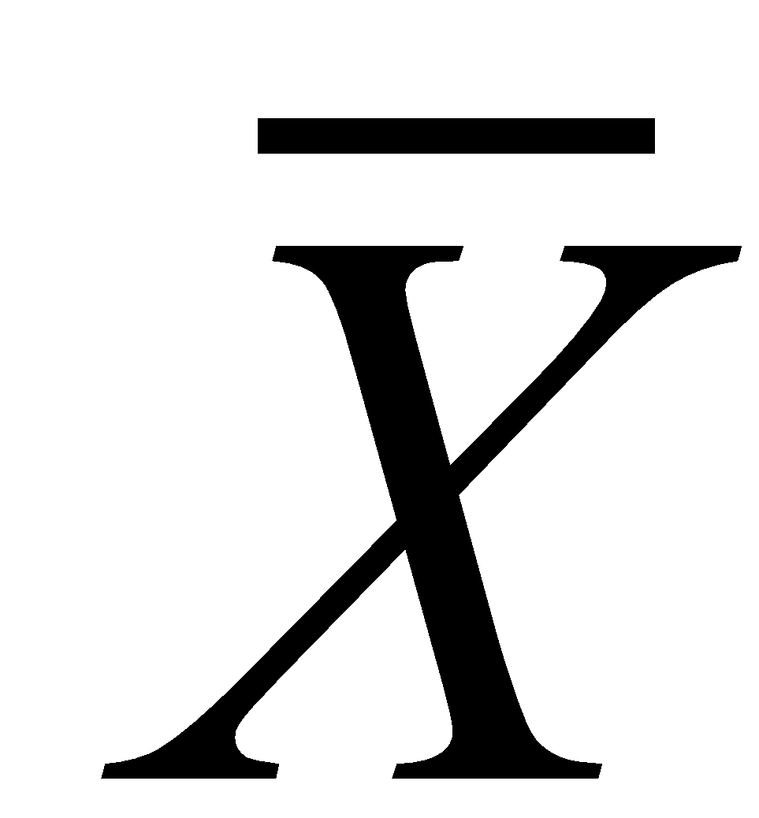
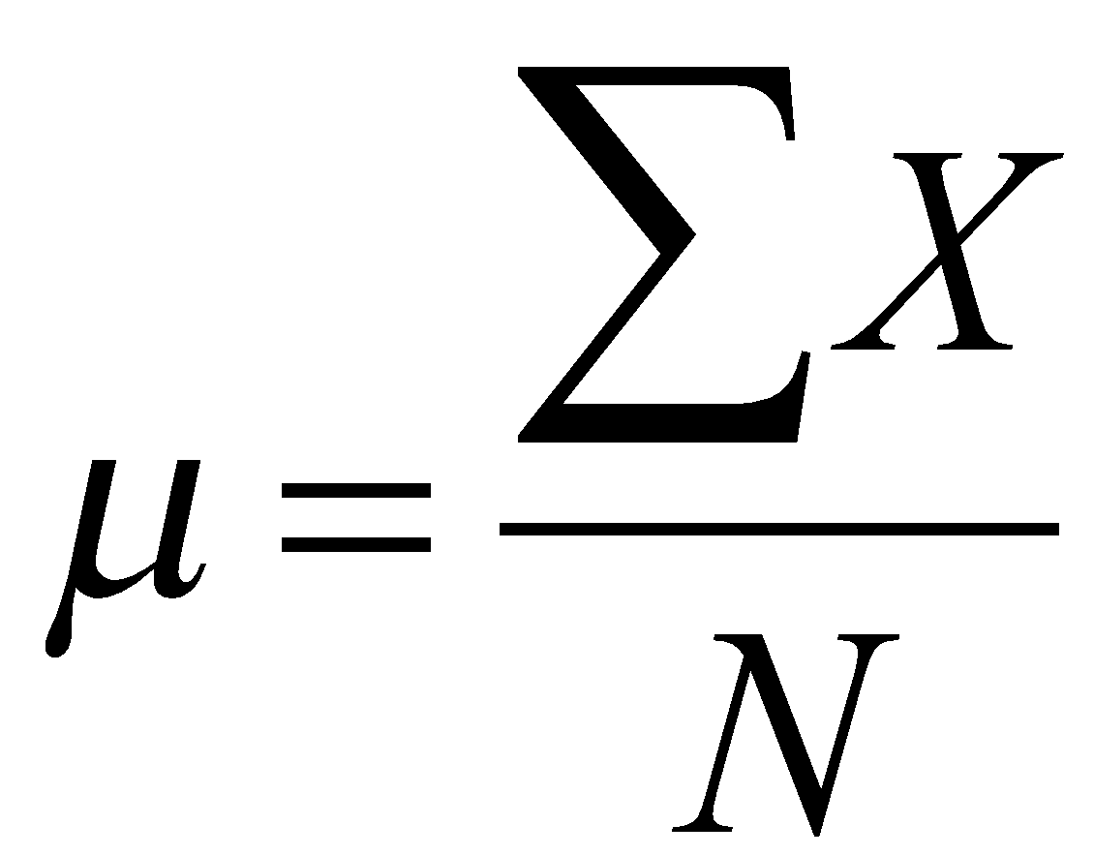
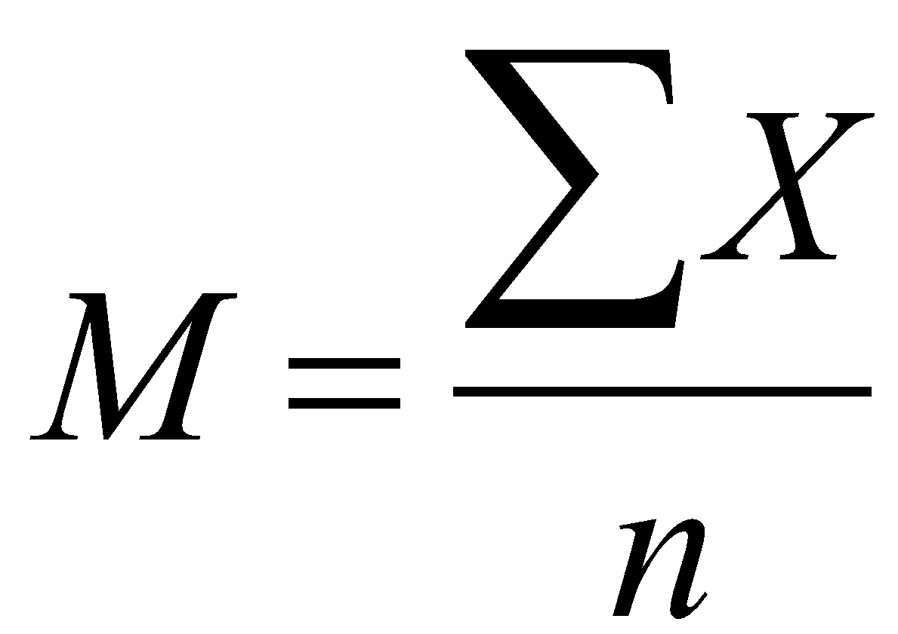
The Mean (M, i.e. the “average”)
The sum of scores (ƩX) in a distribution divided by the number of scores (n or N)
Population Mean (μ)
Sample Mean (M or )

Slide 15
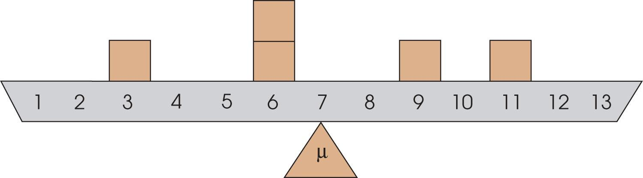
What happens to M when…
We add a value larger than the mean?
We add a value smaller than the mean?
We remove a value larger than the mean?
We add twenty scores equal to the mean?
Mean increases
Mean decreases
Mean decreases
The mean remains the same

Slide 16
When Won’t M Work?
When a distribution is very skewed, the mean will be pulled toward the extremes
When data is from a nominal scale, it is impossible to compute a mean (e.g. what is the mean of “favorite color”?)
When data is from an ordinal scale, it is usually inappropriate to compute a mean (e.g. what is the mean of year in school?)

Slide 17
The Median
The score that divides a distribution exactly in half (50th percentile)
50% of individuals in a distribution have scores above the median and below the median
Odd number of scores:
Median = the score in the middle of an ordered distribution
3, 5, 8, 10, 11
The median
Even number of scores:
Median = the mean of the two scores in the middle of an ordered distribution
1, 3, 5, 8, 10, 11
The median is the average of the middle two scores
(5+8)/2 = 13/2 = 6.5

Slide 18
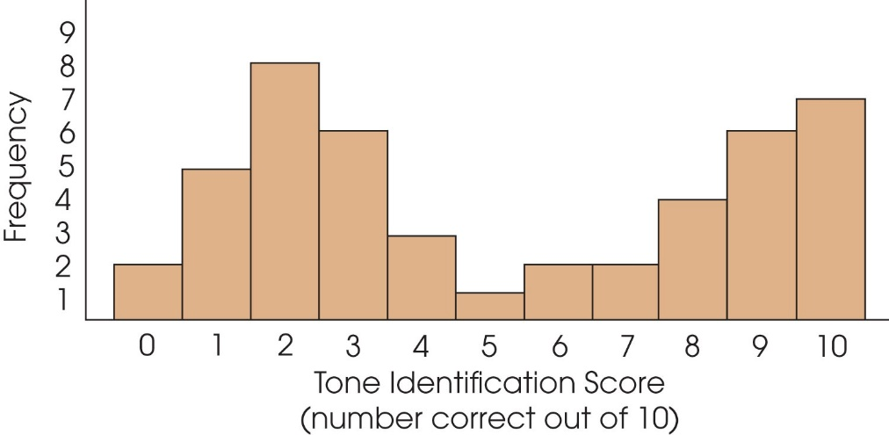
The Mode
The score or category that has the greatest frequency (i.e., the most common observation)
The only measure of central tendency that can be used with nominal data
More than one mode:
Bimodal: A distribution with two scores with the same(ish) highest frequency
Multimodal: A distribution with more than two modes

Slide 19
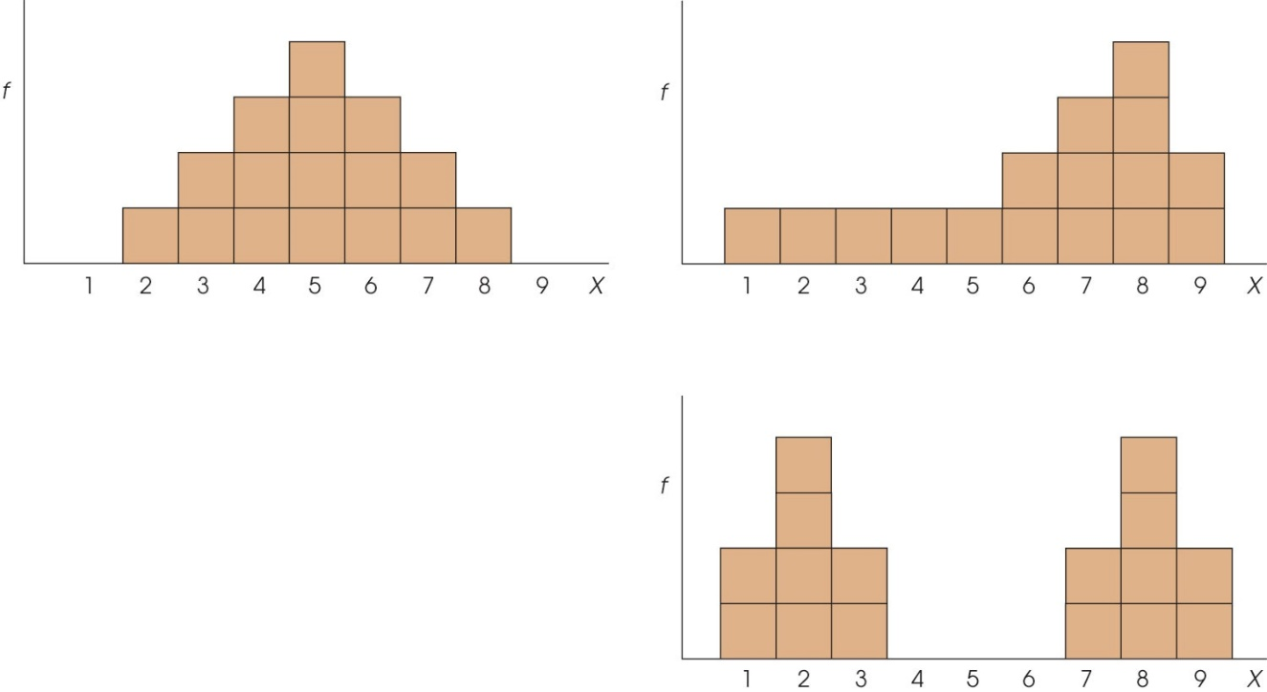

Summarizing Central Tendency
The Mean
The Median
The Mode
Found by adding all the scores and dividing by the number of scores
For continuous scales
The middlemost score, or score that divides the group in half
For continuous and ordinal scales
Most frequently occurring score
For all scales, including nominal scales

Slide 20
A meteorologist is interested in determining how much precipitation occurred in July for 20 US cities.
Here is the amount of rainfall for each city:
Find the mean, median, and mode
3.5 | 1.6 | 2.4 | 4.1 | 3.7
3.9 | 1.0 | 3.6 | 3.4 | 4.2
3.7 | 2.2 | 1.5 | 3.4 | 4.2
2.7 | 0.4 | 3.7 | 3.6 | 2.0

Slide 21
Selecting a Measure of Central Tendency
The Mean (M or x̄ ) is often preferred with continuous data
Uses every score and typically gives a good representative value
Useful in later inferential statistics
However, there are certain situations in which the mean is unable to be used or undesirable for use

Slide 22
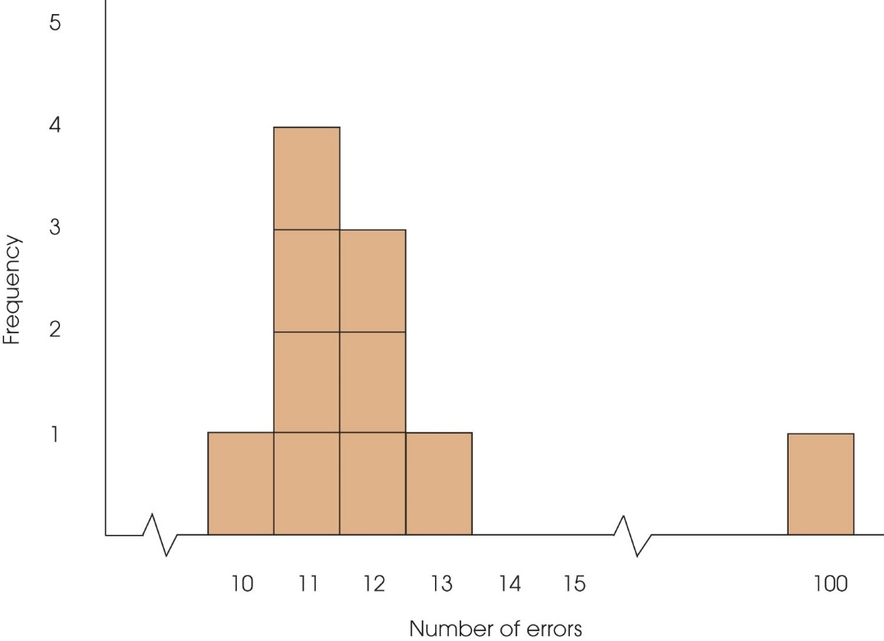
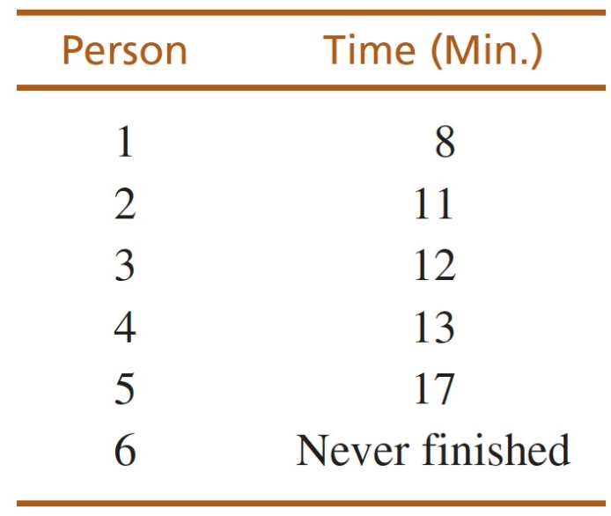
Selecting a Measure of Central Tendency
We use the median for:
Extreme scores or skewed data – the median is not influenced by extreme scores
Undetermined values (e.g., participant drops out before completing a task) –we cannot compute a mean with a missing value
Open-ended distributions – impossible to compute a mean because there is no way to compute ΣX
Ordinal data – the median is defined by direction (half of scores above, half below) and is not defined by distance
Number of Pizzas (X) | f
5 or more | 3
4 | 2
3 | 2
2 | 3
1 | 6
0 | 4

Slide 23
Selecting a Measure of Central Tendency
We use the mode for:
Nominal (categorical) data
Discrete variables (means and medians produce unrealistic values)
“The average family has 2.5 children”
vs.
“The typical family has 2 children”
Description of the shape of the distribution (e.g., “bimodal”; often in addition to M and median)

Slide 24
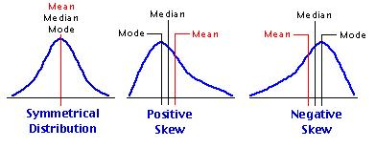
Central Tendency and the Shape of the Distribution
The three measures of central tendency are often systematically related to each other

Slide 25
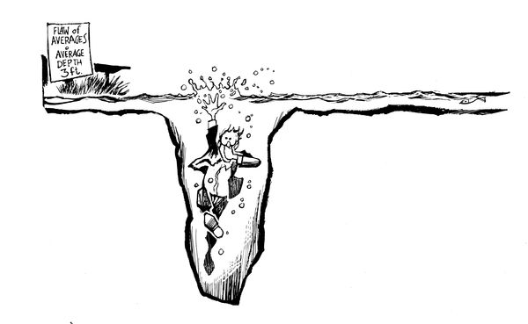
A statistician drowned crossing a river that was 3-feet deep on average

Slide 26
Measures of Variability

Slide 27
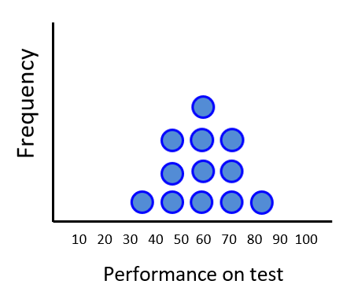
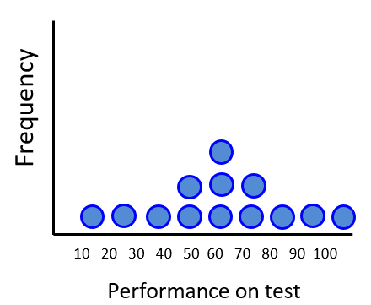
What is variability?
A statistical measure (descriptive stat) that describes the spread of a distribution

Slide 28
Measures of Variability
Range: Difference between highest and lowest scores
X_{max} – X_{min}
Quiz Scores: 2, 6, 8, 1, 3, 9, 10, 4, 7
Range = 10 – 1 = 9

Slide 29
Problems with the range
The range can be misleading as a measure of variability because it only takes two numbers into account
Which of the following data sets is more variable?
1, 10, 10, 10, 10, 10
1, 2, 3, 4, 5, 6

Slide 30
Measures of Variability
Range: Difference between highest and lowest scores
Variance (s² or σ²): The average of squared deviations from the mean
Standard Deviation (s or σ or SD ): The typical amount that each score varies (deviates) from the mean; the square root of the variance

Slide 31
The Variance (s²)
x | x - M
6 | -2
6 | -2
6 | -2
10 | 2
10 | 2
10 | 2
6 | -2
10 | 2
6 | -2
10 | 2
8 | 0
M = 8
Calculating the variance:
Find the mean
Subtract the mean from every score
1 (N-1)

Slide 32
The Variance (s²)
x | x - M | (x-M)²
6 | -2 | 4
6 | -2 | 4
6 | -2 | 4
10 | 2 | 4
10 | 2 | 4
10 | 2 | 4
6 | -2 | 4
10 | 2 | 4
6 | -2 | 4
10 | 2 | 4
8 | 0 | 0
M = 8 |  | SS = 40
Calculating the variance:
Find the mean
Subtract the mean from every score
Square every deviation from the mean
Sum all of the squared deviations (SS)

Slide 33
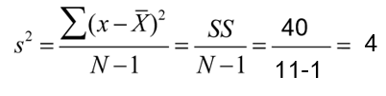
Sample Variance (s² or σ²)
x | x - M | (x-M)²
6 | -2 | 4
6 | -2 | 4
6 | -2 | 4
10 | 2 | 4
10 | 2 | 4
10 | 2 | 4
6 | -2 | 4
10 | 2 | 4
6 | -2 | 4
10 | 2 | 4
8 | 0 | 0
M = 8 |  | SS = 40
Calculating the variance:
Find the mean
Subtract the mean from every score
Square every deviation from the mean
Sum all of the squared deviations (SS)
For sample variance: Divide the sum of squares by the total number of observations in the sample (n) minus 1

Slide 34
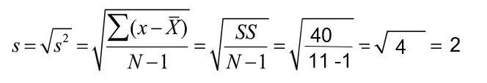
Sample Standard Deviation (s or σ)
The square root of the variance
Question: Why compute the standard deviation? Why not just report the variance of a distribution?
Answer: SD is expressed in the same units as the data

Slide 35
Normal Distributions

Slide 36
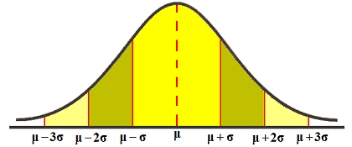
Understanding SD Graphically
68.26%
94.46%
99.73%

Slide 37
Test your understanding
Sample 1: n = 25, M = 80
Sample 2: n = 25, M = 80
Does a score of 85 mean the same thing?
Consider if for Sample 1: s = 1 and for Sample 2: s = 10
Which situation would a score of 85 be a “better” score?
A score of 85 in Sample 1 means that this score is 5 standard deviations above the mean
A score in Sample 2 means that this score is ½ a standard deviation above the mean

Slide 38
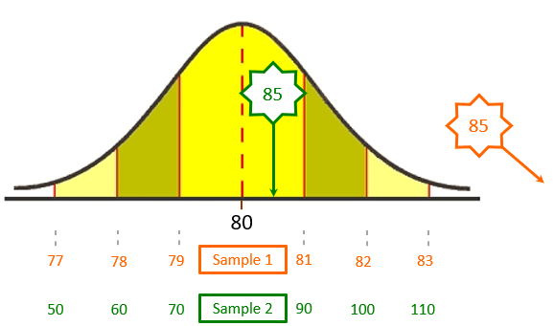
Test your understanding
Sample 1: n = 25, M = 80, s = 1
Sample 2: n = 25, M = 80, s = 10

Slide 39
Properties of the SD
For X
n = 6
M = 3.5
SD = 1.87
For X + 1
n = 6
M = 4.5
SD = 1.87
X
1
2
3
4
5
6
X + 1
2
3
4
5
6
7
1.87
3.5
Adding a constant to each score results in the addition of the same constant to the M, but no change in the SD (s or σ)

Slide 40
Properties of the SD
For X
n = 6
M = 3.5
SD = 1.87
For X + 1
n = 6
M = 4.5
SD = 1.87
X
1
2
3
4
5
6
X + 1
2
3
4
5
6
7
1.87
4.5
Adding a constant to each score results in the addition of the same constant to the M, but no change in the SD (s or σ)

Slide 41
Properties of the SD
For X
n = 6
M = 3.5
SD = 1.87
X
1
2
3
4
5
6
X × 2
2
4
6
8
10
12
1.87
3.5

Slide 42
Properties of the SD
For X
n = 6
M = 3.5
SD = 1.87
For X × 2
n = 6
M = 7
SD = 3.74
X
1
2
3
4
5
6
X × 2
2
4
6
8
10
12
3.74
7
Multiplying every score by a constant results in the multiplication by the same constant of the M, and multiplication by the same constant of the SD (s or σ)

Slide 43
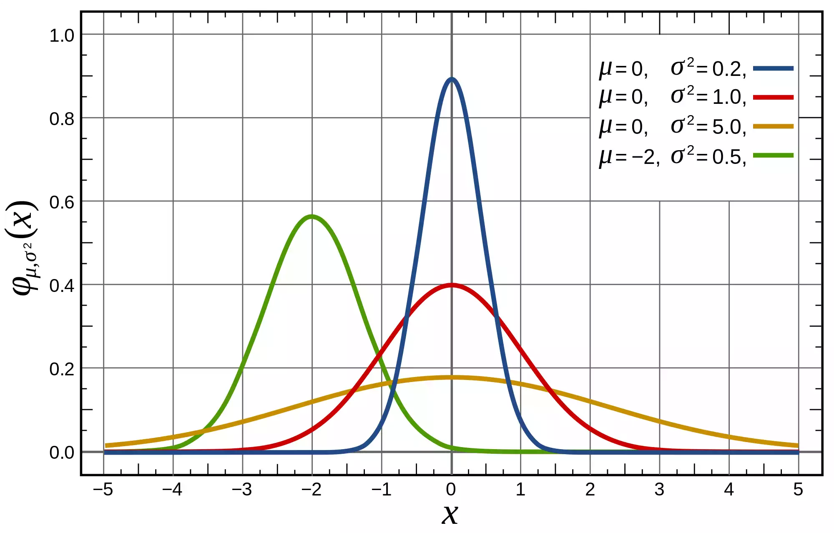
Comprehension Check

Slide 44
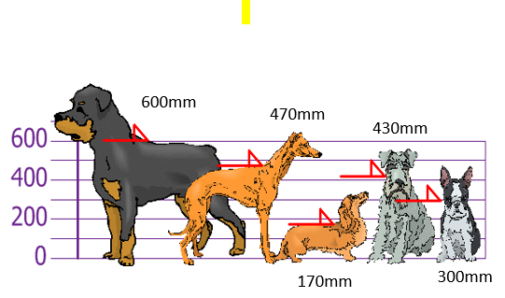
Now Let’s Try it Together calculate M and s

